Slide 1

Students Helping Students: Longitudinal Analysis of Risky Drinking Behavior at the University of Virginia from 2017-2023
Nicholas Cagliuso & Samy Kebaish
August 8th, 2024

Slide 2
Table of Contents
Sponsor & Project Background
Data Discussion
Methods & Findings – Identifying Temporal Patterns in Alcohol Abuse
Methods & Findings – Analysis of Linked Datasets
Other Findings
Acknowledgements
Notes:
Problem:
How can we interpret predictive models to understand which age groups are most at risk for COVID-19 infection?

Slide 3

Sponsor & Project Background

Slide 4


About the Sponsor: U.Va Student Health & Wellness
U.Va Student Health & Wellness (SHW) is the primary source on Grounds for U.Va Undergraduate and Graduate Students to receive non-urgent medical care and other services such as counselling, mentorship, assistance for student disabilities, and more (Figure 1).
In addition to its service offerings, SHW’s mandate extends to improving student health and well-being through University Initiatives, clinical trials, and research through the Student Health Office of Research Excellence (SHORE), which includes the Student Health Research Database.
Notes:
SHORE is part of the College Health Surveillance Network (CHSN), a multi-institutional, de-identified medical records dataset from student health centers (SHCs) that are part of a nationally representative sample of colleges and universities. Among SHORE’s research priorities includes the Student Health Research Database (SHRD), comprehensive integrated data repository with more than 120,000 student cases from 2009 to the present

Slide 5
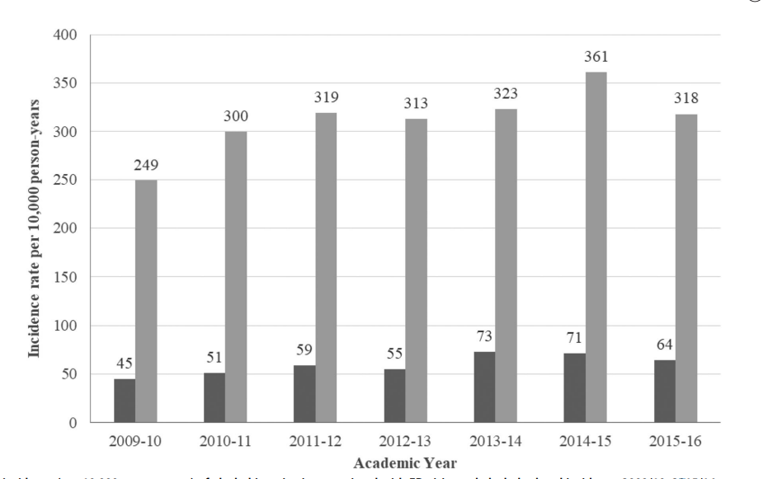
Project Background
The SHRD has allowed for invaluable public health research including a 2020 paper investigating the incidence of “alcohol-related incidents” at the Emergency Department from 2009 - 2016.
While our Sponsors sought to extend their preliminary research once the 2018-2023 data was available, in light of evidence of how the COVID-19 pandemic may have affected mental health status and substance abuse incidence, this prompted two questions which drove the Thrusts of our Capstone:
Figure 1. Incidence (per 10,000 person-years) of alcohol intoxication associated with ED visits and alcohol-related incidents, 2009/10–2015/16.
Were there statistically significant differences in risky drinking behavior before, during, and after COVID?
In what ways do “Alcohol” and “Non-alcohol” cohorts potentially differ when linking the datasets together?

Slide 6
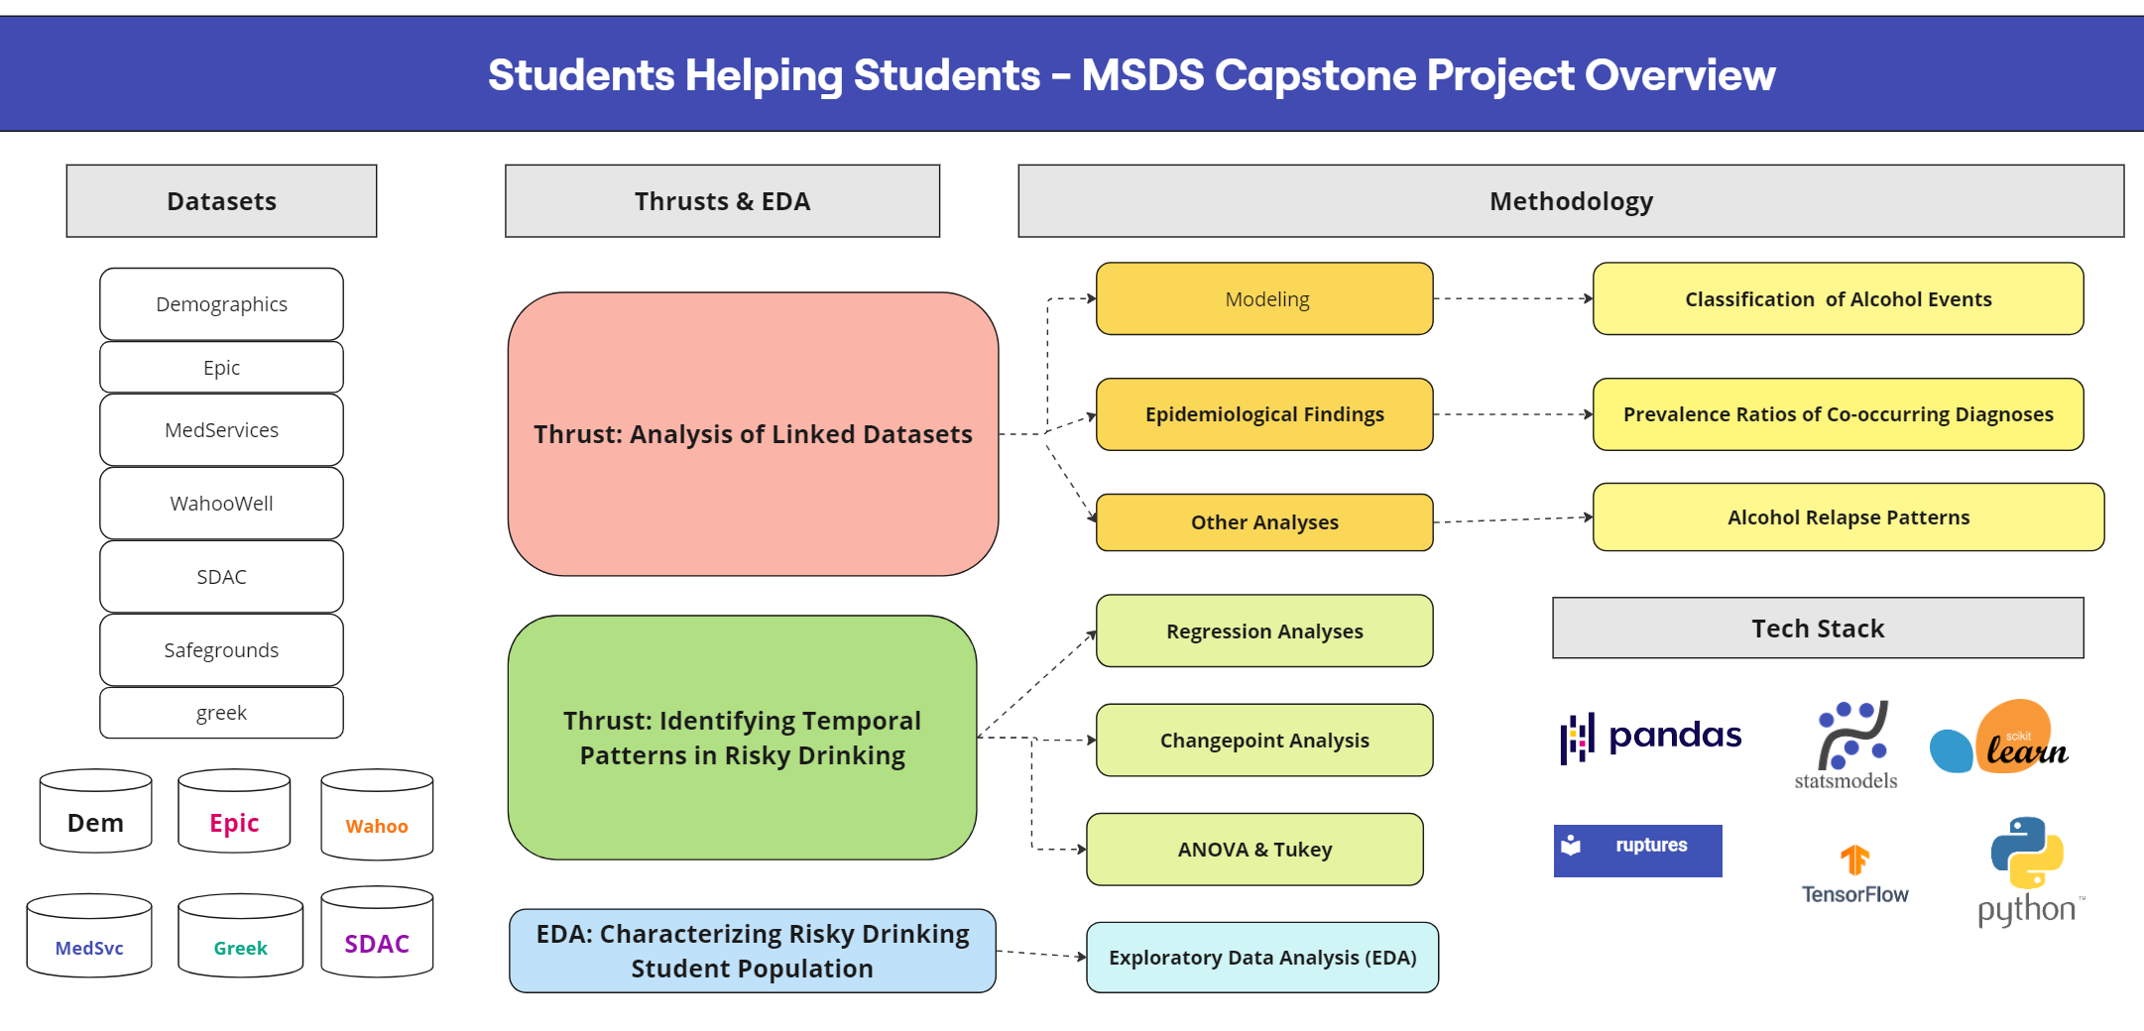
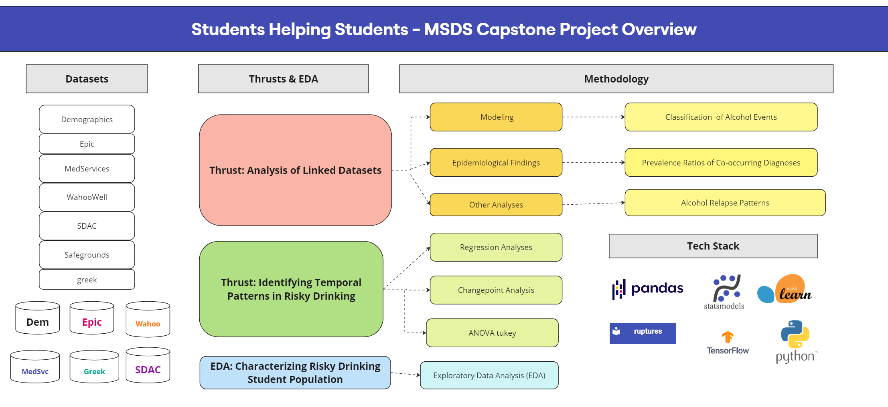

Slide 7
Data Discussion

Slide 8
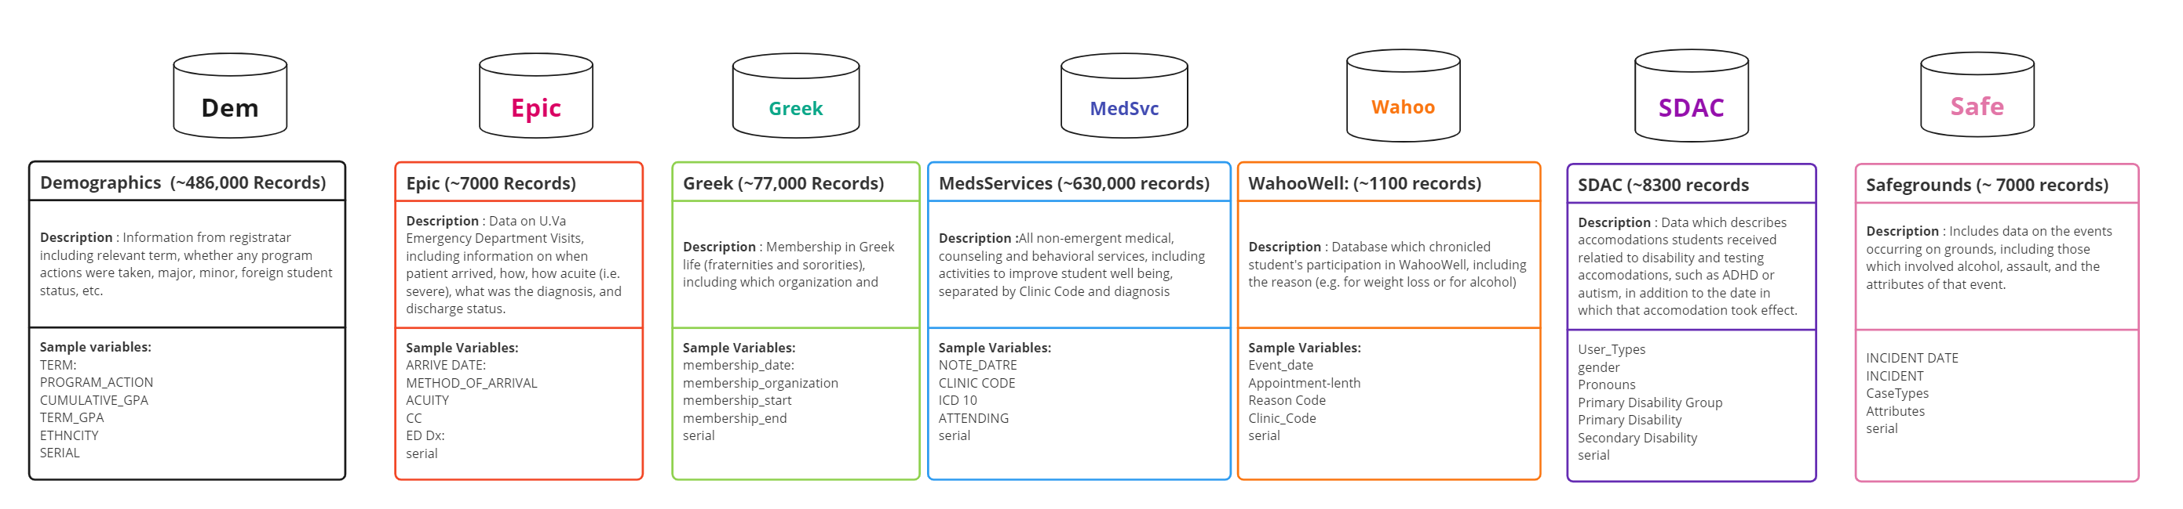
About the Data
The Data analyzed included de-identified student patient data from 2018-2023, with each student provide unique serial number, spanning seven datasets (Figure 1). The use of unique serial numbers allowed for linking of student data across various datasets, presenting additional features

Slide 9
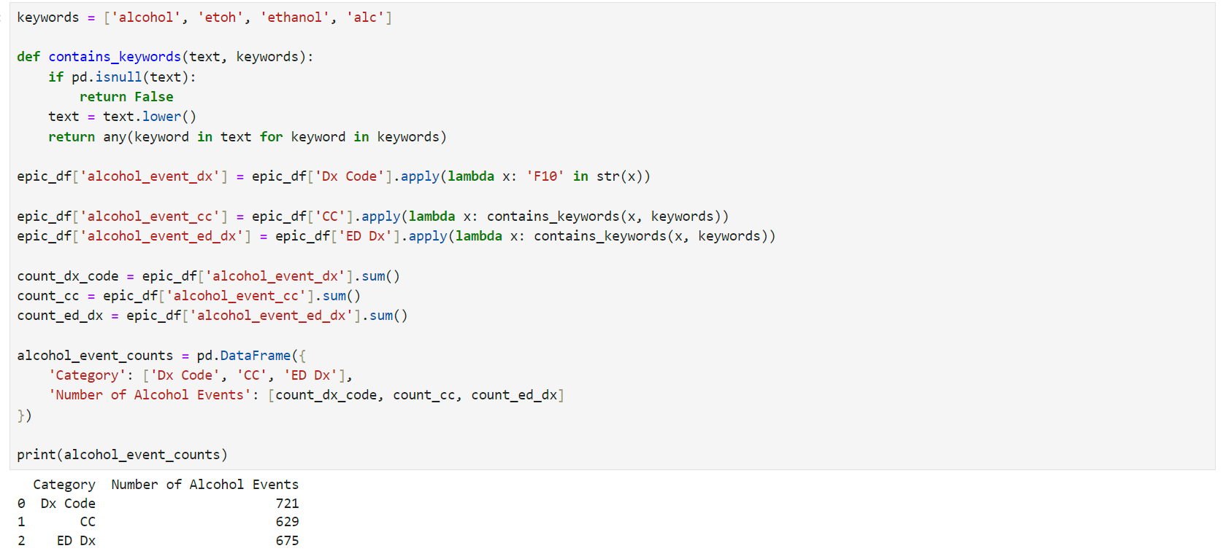
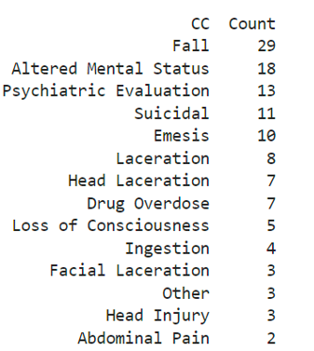
Assumptions & Limitations
Assumptions | Descriptions | How
Classifying Alcohol Event | An alcohol event can be classified in numerous ways based on the dataset | Using the ICD-10 Code “F10” and standardizing the column name for the parent category of Alcohol Abuse Disorders
COVID-19 Period Dates | There is no universal standard as to what constitutes “Pre-CoVID”, “COVID, and “Post COVID Eras” | Pre-COVID (Before March 1st, 2020) COVID: (Between March 1st, 2020 and June 1st, 2022) Post-COVID (After June 1st, 2022)
Nature of Alcohol events | How to interpret alcohol events in different datasets? | MedServices: As these have been found to occur during the day, and often through the CAPS clinic Code, for alcohol management as opposed to acute episodes of alcohol poisoning (Epic)
Limitations | Descriptions | How Managed
Imbalanced Data | Events that are positive for alcohol abuse occur in only 10% of Epic visits and 1% of Medservice Visits | Merge datasets to increase sample size. Used upsampling, especially with prediction models, through techniques such as SMOTE
Alcohol visits can be “Self-selecting” | Person who engagte in alcohol abuse may feel uncomfortable/embarrassed, and hence the numbers are likely lower than anticipated | When comparing non-alcohol and alcohol events, only did so using students who had a medical presentation in the emergency department and medservices.
Data is incomplete | For example, not all students who had alcohol events, have corresponding grades in the demographics dataframe | Accounted for feature extraction during modeling using students with a threshold number of events to avoid dilution of signal.

Slide 10
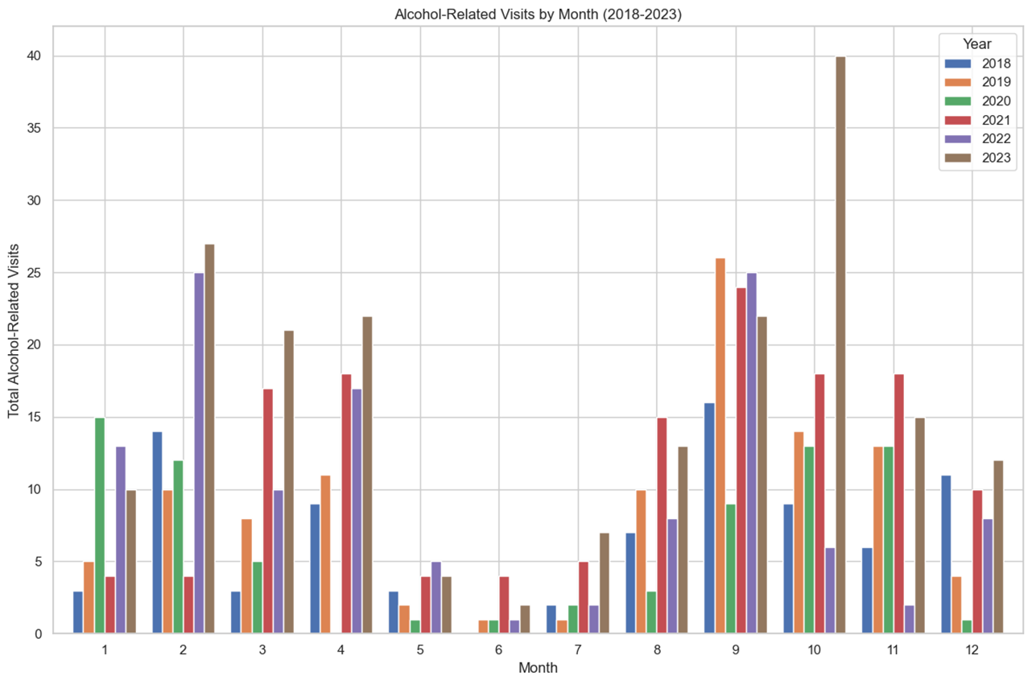
Exploratory Data Analysis
EDA was conducted at the onset, which helped to guide subsequent investigations. For example, for Emergency Room alcohol_events from 2018-2023, there appears to be a gradual increase per period when looking at the monthly counts, although seasonality persists (Figure 1), and an overall increase in alcohol events per day (Table 1)
Era | # Alcohol Events | Days in Period | Alcohol Events per Day
Pre-COVID | 215 events | 790 Days | .272 Alcohol Events / Day
COVID | 259 Events | 822 Days | .315 Alcohol Events / Day
Post-COVID | 216 Events | 579 Days | .373 Alcohol Events/Day
All Eras | 734 Events | 2191 Days | .335 Alcohol Events/Day
Where Pre-COVID: January 1st – 2018 – March 1st, 2020; March 1st, 2020 – June 1st, 2022; Post-COVID: June 2022 – December 31st, 2023)

Slide 11
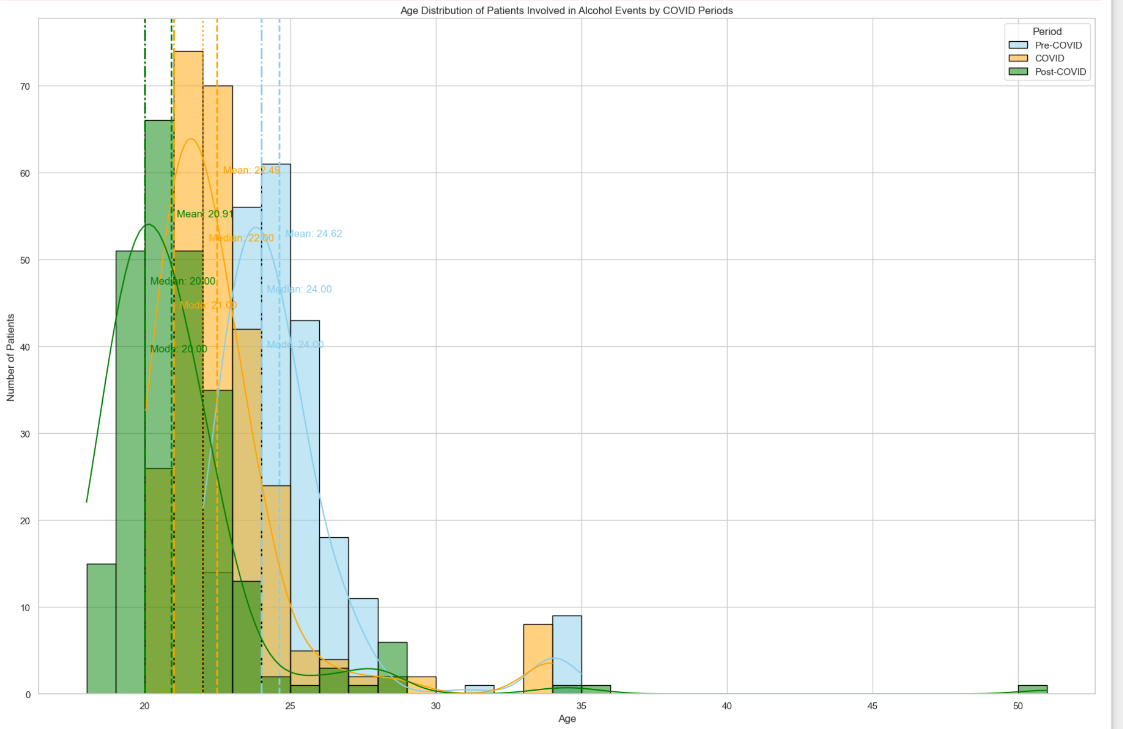
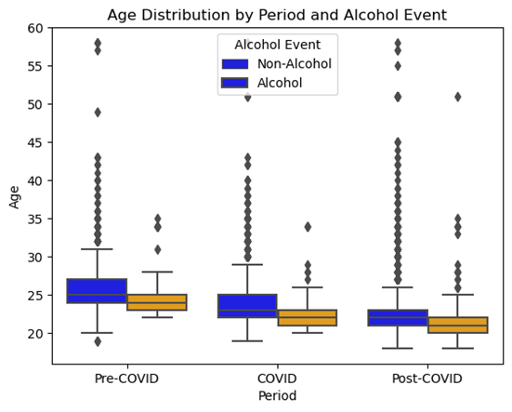
Exploratory Data Analysis
COVID-19 Era | Acuity Abbr. | Proportion of Alcohol Visits
Pre-COVID | 1 . Immediate | 1.4%
 | 2. Very Urgent | 10.8%
 | 3 . Urgent | 47.2%
 | 4. Standard | 39.2%
 | 5. Not Urgent | 1.4%
COVID | 1. Immediate | 0.0%
 | 2. Very Urgent | 17.2%
 | 3. Urgent | 58.4%
 | 4. Standard | 23.2%
 | 5. Not Urgent | 1.2%
Post-COVID | 1. Immediate | 0.0%
 | 2. Very Urgent | 25.3%
 | 3. Urgent | 62.9%
 | 4. Standard | 11.0%
 | 5. Not Urgent | 0.8%
When looking at potential features of interest, we see a progress decrease in age of students involved in alcohol events in the Epic Dataset, in addition to an increase in acuity of such events.

Slide 12
Methods & Findings –
Identifying Temporal Patterns in Alcohol Abuse

Slide 13
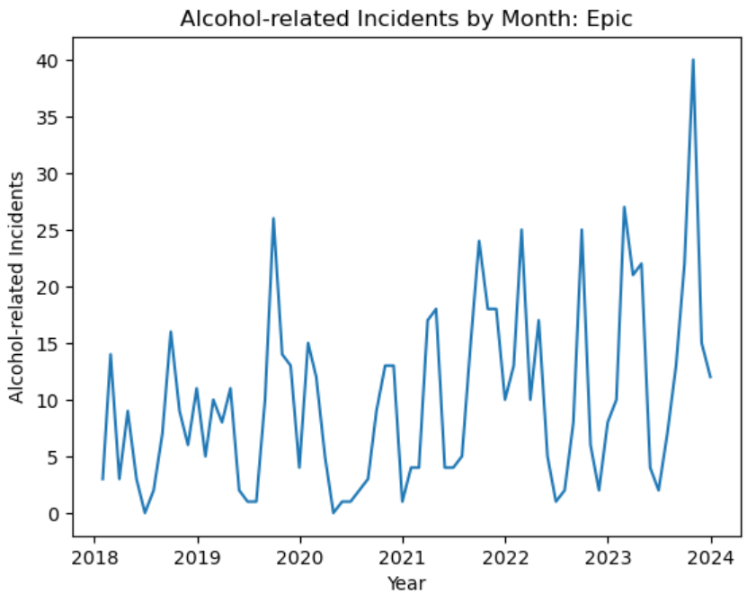
Data Pipeline & Processing: Identifying Temporal Patterns in Risky Drinking
For each of Epic, Med Services, and SafeGrounds:
Calculate monthly alcohol-related incidents
Adjust for seasonality
  Calculate monthly alcohol-related incidents per 1000 total incidents
Smooth Data
  CUSUM Chart
Ex.: Monthly alc.-related incidents, pre- seasonality adjustment and smoothing.

Slide 14
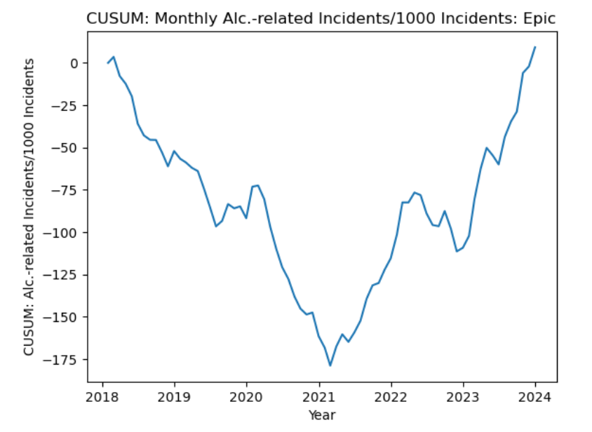
Data Pipeline & Processing: Identifying Temporal Patterns in Risky Drinking, Cont’d.
Ex.: Seasonality--adjusted and smoothed data

Slide 15
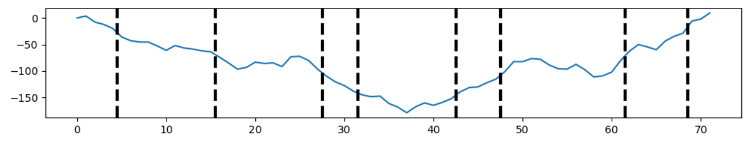
Change Point Detection
Ensemble of Methods:
  Dynamic Programming, Pelt, Kernel Change Detection, Binary Segmentation, Bottom-Up
    Ran for each of smoothed Epic, Med Services, and SafeGrounds data
Ex.: Pelt on smoothed Epic data

Slide 16
Change Point Detection Results
Most frequently detected change point:
Epic: November 2021 (7/10 methods)
Med Services: May 2018 (7/10 methods
SafeGrounds: November 2018 (8/10 methods)
Pelt:
Epic: Detected 8 change points including April 2020
Med Services: Detected 11 change points including April 2020
SafeGrounds: Detected 11 change points including March 2020

Slide 17
Analysis of Variance and Tukey Tests
For each of Epic, Med Services, and SafeGrounds:
Calculated mean monthly alcohol-related incidents per 1000 total incidents grouped by month, year, and “Covid Era”
  Pre-Covid = Data through Feb. 2020
  Covid = Mar. 2020 - Jul. 2021
  Post-Covid = Aug. 2021 onwards
Ran one-way ANOVA tests on each set of means
If null hypothesis was rejected, ran Tukey tests on that set of means

Slide 18
Analysis of Variance Results
Rejected Null Hypothesis:
Epic:
  Year (99% significance level)
  Covid Era (99% significance level)
Med Services:
  Year (99% significance level)
  Covid Era (99% significance level)
SafeGrounds:
  Covid Era (90% significance level
Failed to reject the null hypothesis at the monthly level for all datasets.

Slide 19
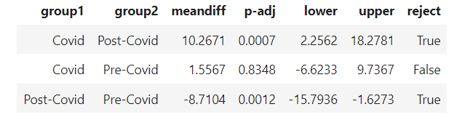
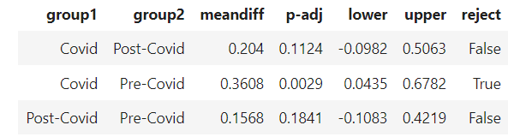
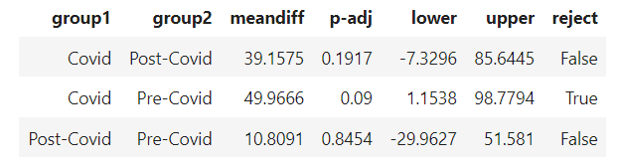
Tukey Test Results by Covid Era
Epic
Med Services
SafeGrounds

Slide 20
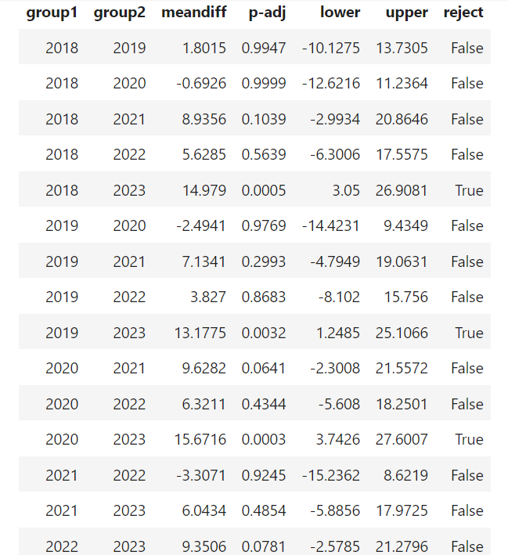
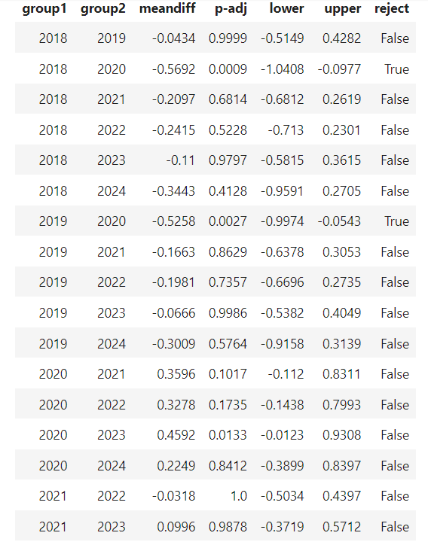
Tukey Test Results by Year
Epic
Med Services

Slide 21
Linear Regressions
For each of Month, Year, and Covid Era in Epic, Med Services, and SafeGrounds:
If null hypothesis was rejected in ANOVA -> regressed against monthly alcohol incidents per 1000 total incidents
If null hypothesis was rejected for multiple variables -> all regressed against monthly alcohol incidents per 1000 total incidents

Slide 22
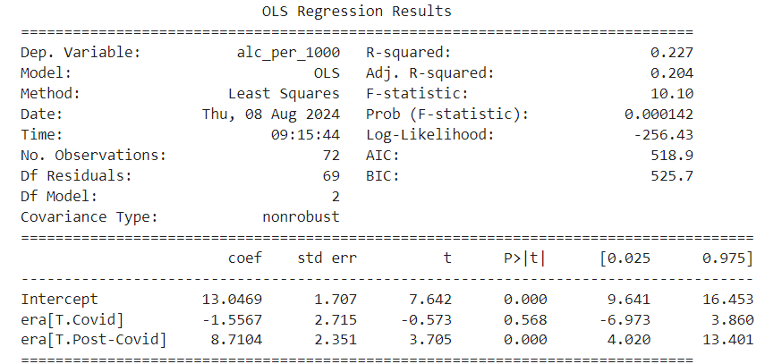
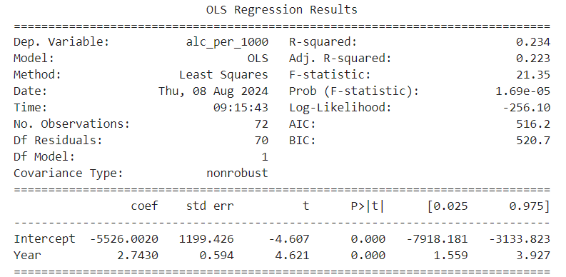
Single Linear Regression Results: Epic
Covid Era
Year

Slide 23
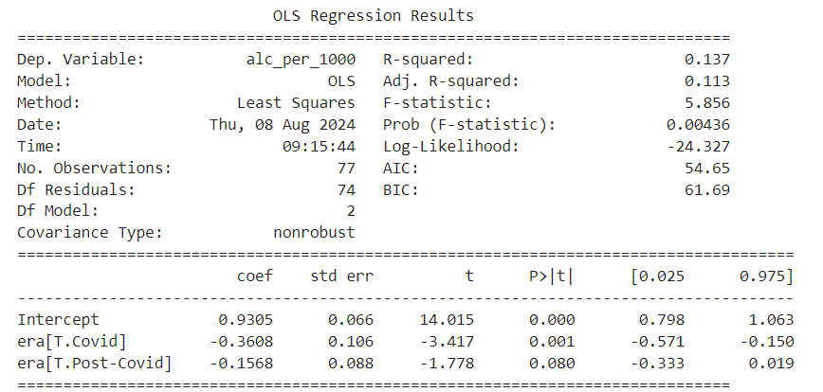
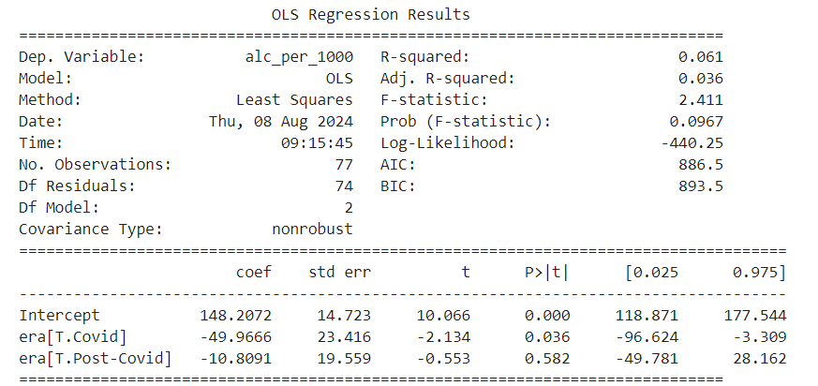
Single Linear Regression Results: Med Services and SafeGrounds
Med Services: Covid Era
SafeGrounds: Covid Era

Slide 24
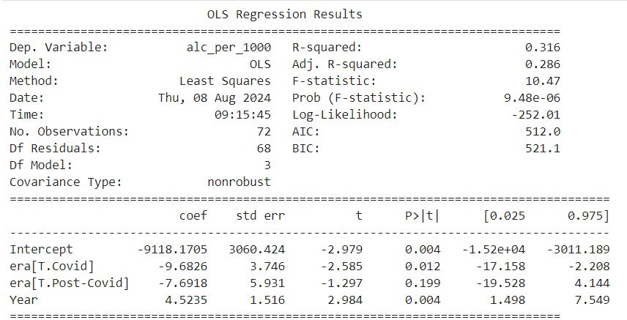

Multiple Linear Regression Results
Epic: Year + Covid Era
Med Services: Year + Covid Era

Slide 25
Methods & Findings –
Analysis of Linked Datasets

Slide 26
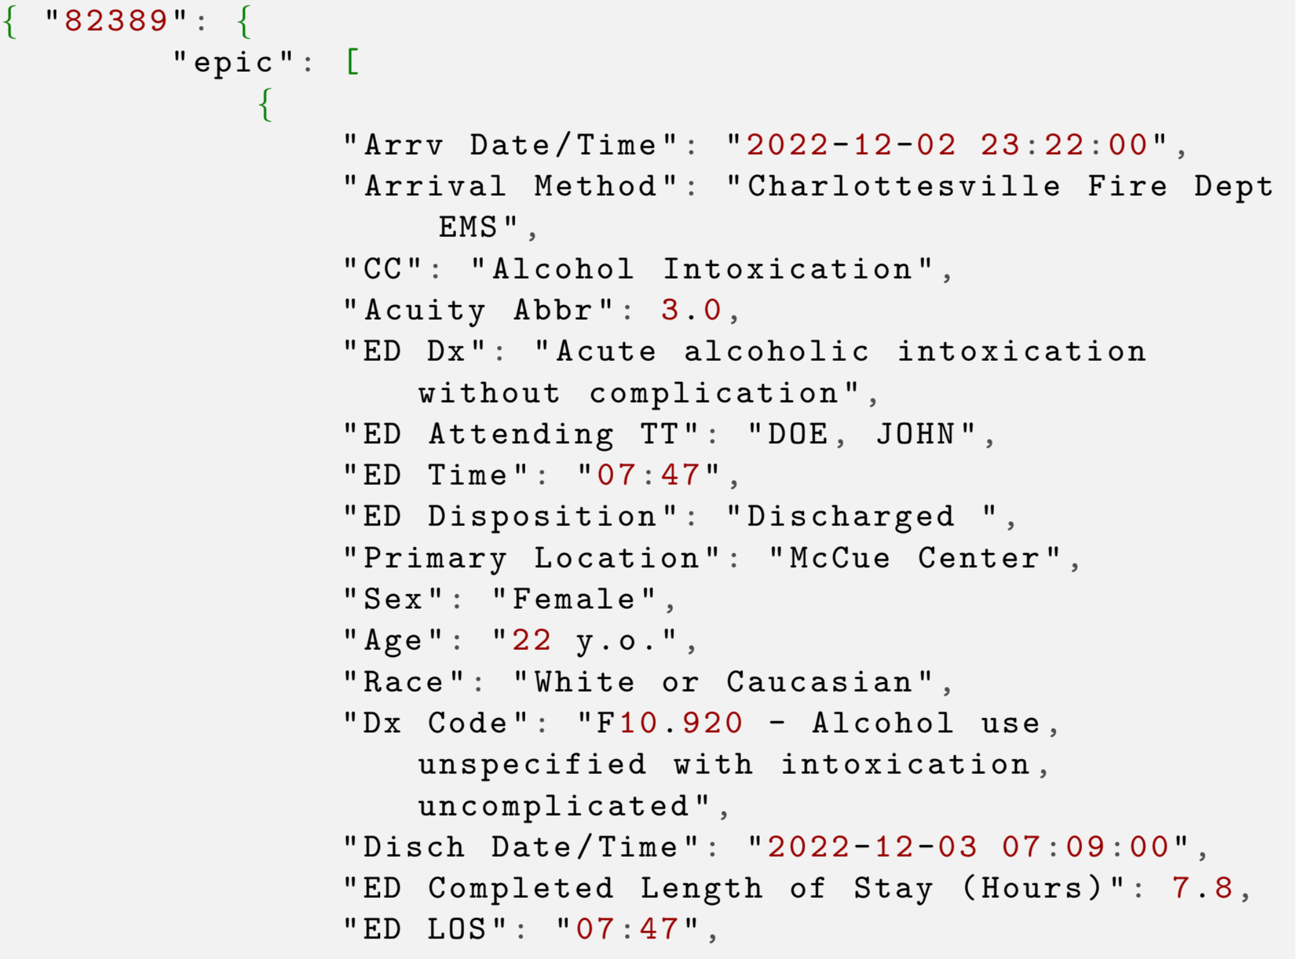
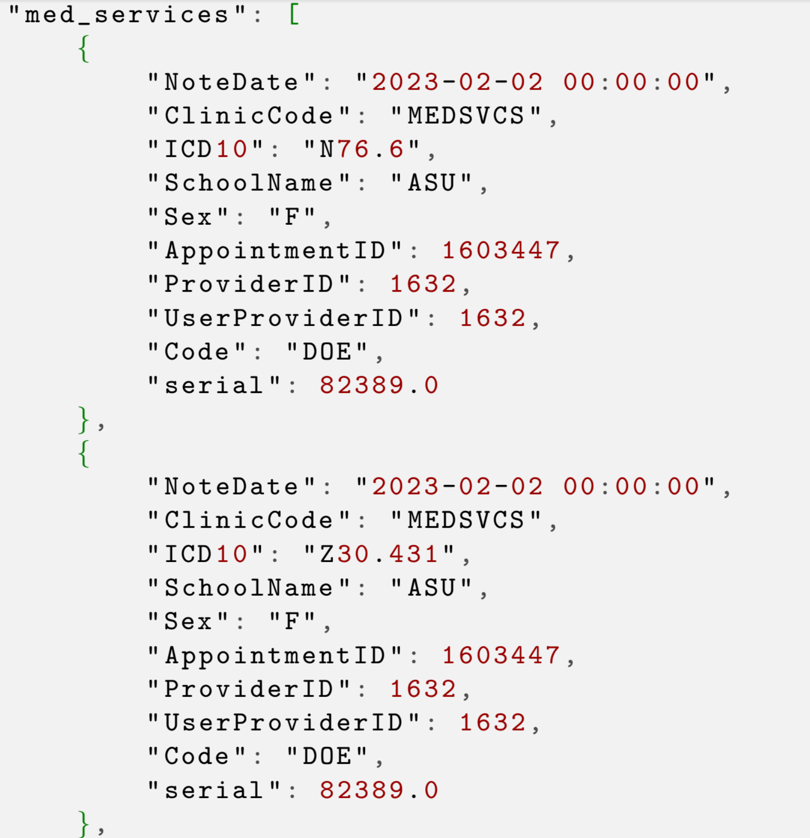
Classification of Emergency Department Alcohol Events using Machine Learning
Analysis of the Linked Datasets required processing the data to extract and impute features, and develop congruent sequences when linking datasets to ensure data linkage through common serial numbers.

Slide 27
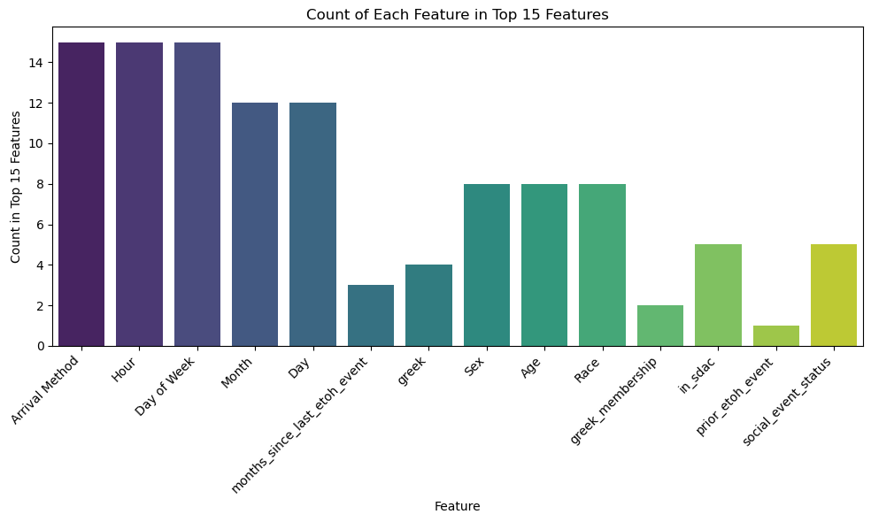
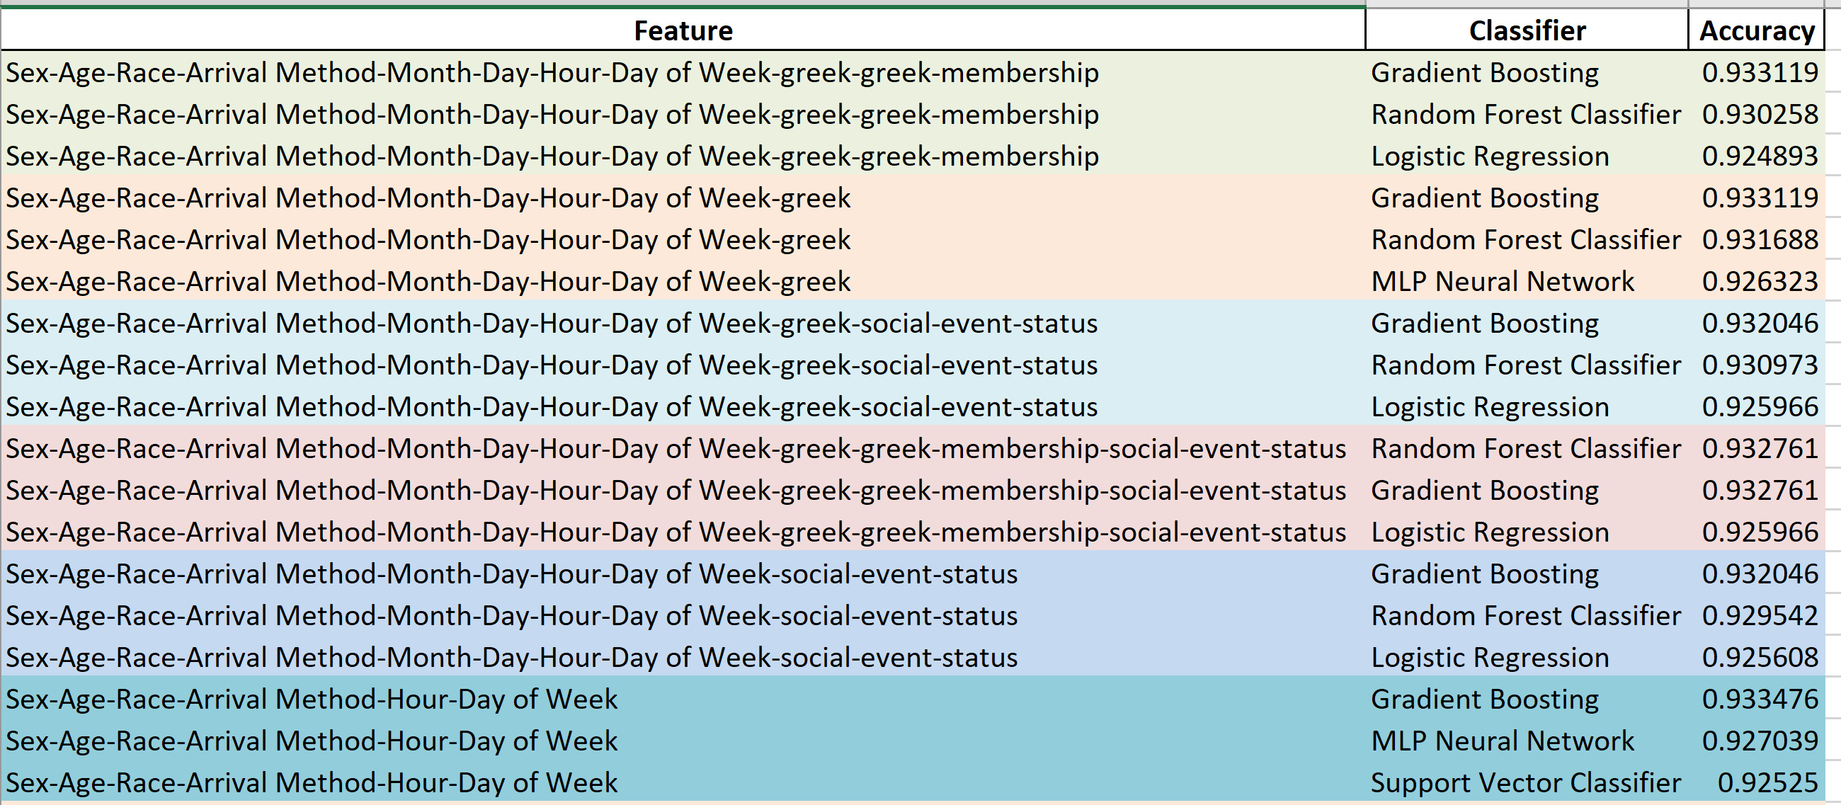
Classification of Emergency Department Alcohol Events using Machine Learning

Slide 28
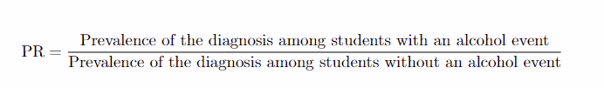
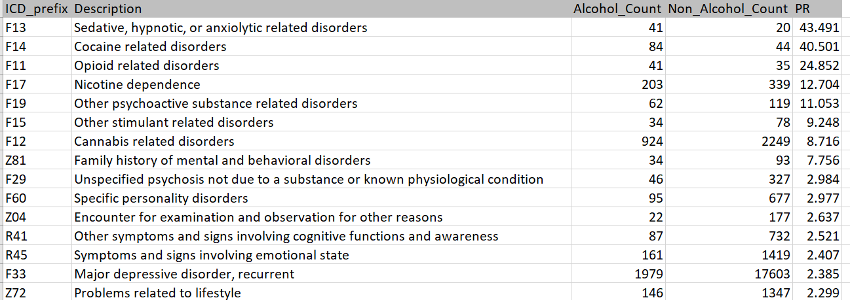
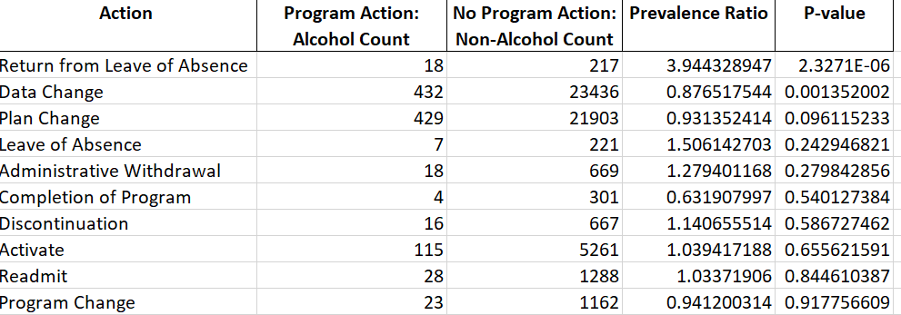
Epidemiological Findings
When combining medservices and epic datasets and evaluating the prevalence of non-alcohol related diagnoses, there is evidence of potential predispositions to alcohol use, in addition to comorbidities, such as evidence of potential polysubstance abuse.
Similarly, when evaluating the same cohorts for Prevalence of Program Actions linking with the Demographics Dataset, there is evidence of substantial differences.

Slide 29
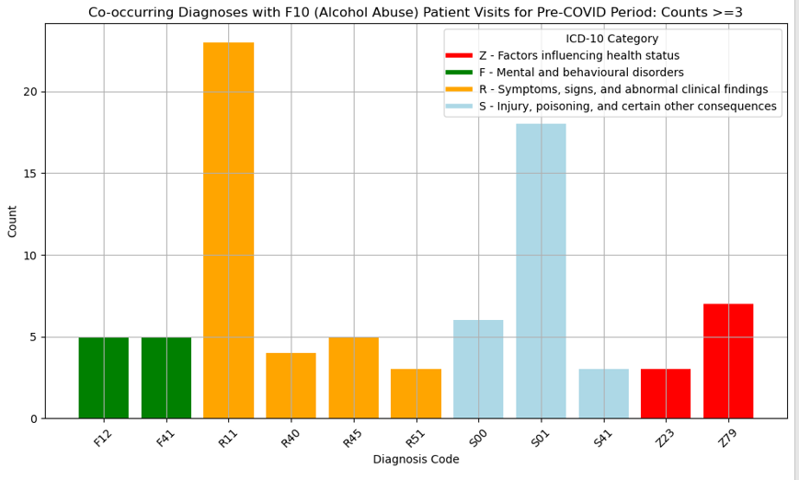
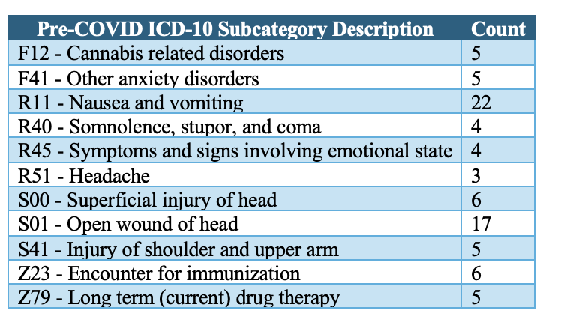
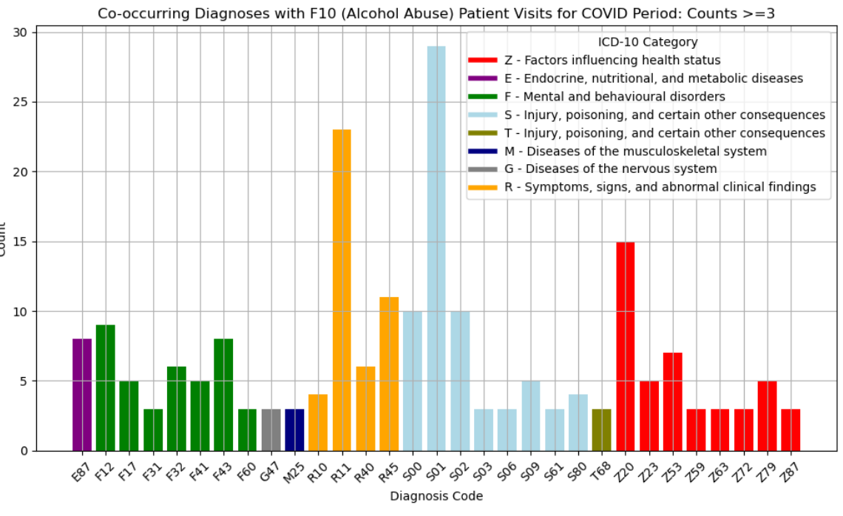
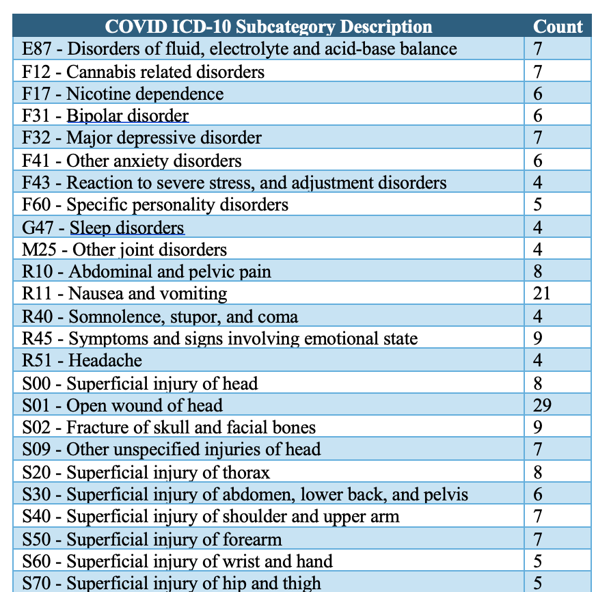
Epidemiological Summary & Findings
Similarly, there are intrasample differences when looking at the characteristics even for just the Emergency Department Data Alone. For example, the number and variety of secondary diagnoses jumps substantially from Pre-COVID to COVID

Slide 30
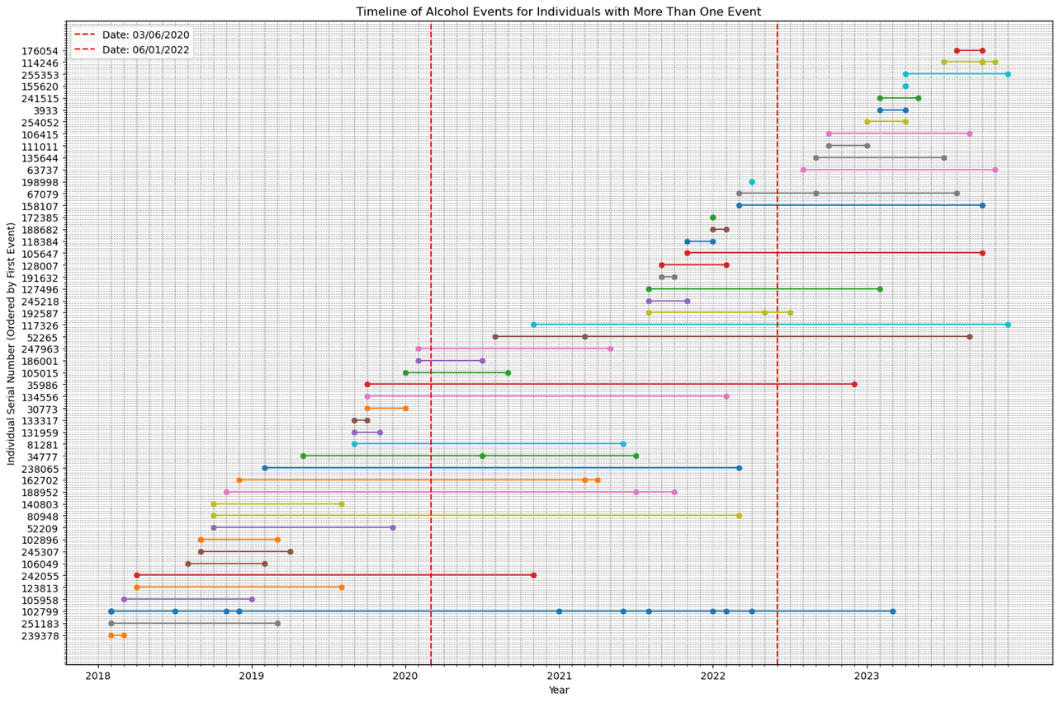
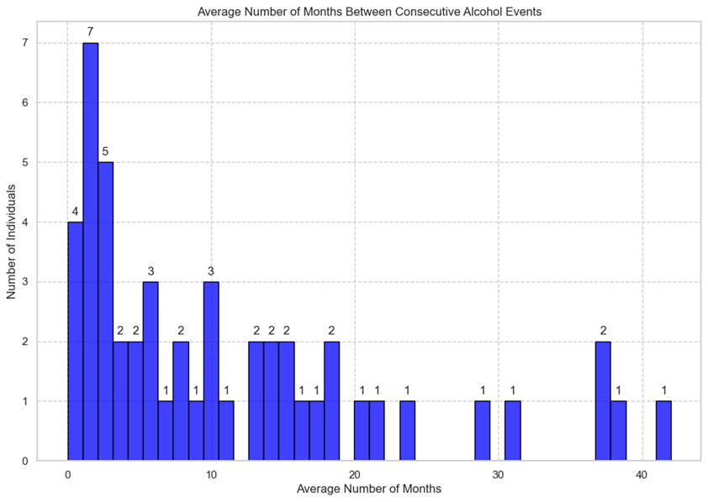
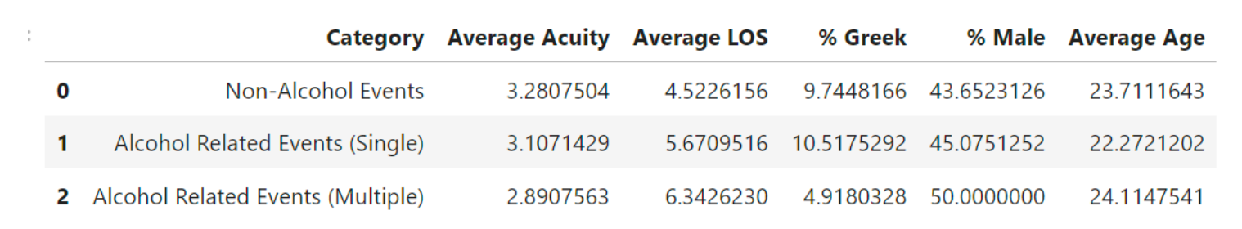
Other Findings Continued

Slide 31
Benefits of this Work & Next steps
Understanding Risk Factors and Prevention: By comparing alcohol-consuming students with non-alcohol-consuming peers, researchers can identify specific risk factors associated with alcohol use, such as stress, social influences, or mental health issues which can inform the development of targeted prevention programs
Mitigate Academic Performance and Health Through Targeted Interventions: Identifying correlations between alcohol use and lower GPA, absenteeism, or health complications can lead to the implementation of support systems, such as counseling services or academic interventions, to help affected students succeed.
Informing Policy and Campus Resources: Findings from such research can guide university policies and the allocation of resources, such as might increase funding for mental health services, create more or revise existing alcohol policies

Slide 32
Acknowledgements

Slide 33




Dr. Christopher Holstege
Acknowledgements
Dr. Rita Farah
Dr. Adam Tashman
Rebecca Ferrara, M.Sc.

Slide 34


Capstone Team
Nicholas Cagliuso
Samy Kebaish

